Slide 1
MOST ENTERTAINING F1 CIRCUIT
Andrew Wiraatmaja
Notes:
Hello everyone, let me introduce myself, my name is Andrew Wiraatmaja and today I will present about my Data Visualizations project regarding which F1 circuit is the most entertaining.

Slide 2
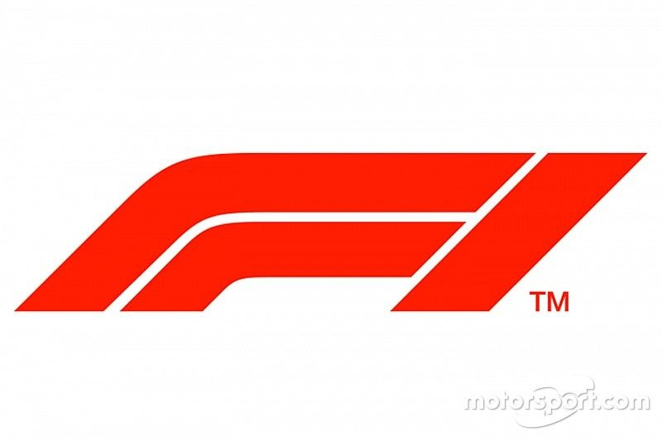
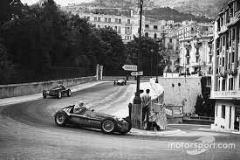
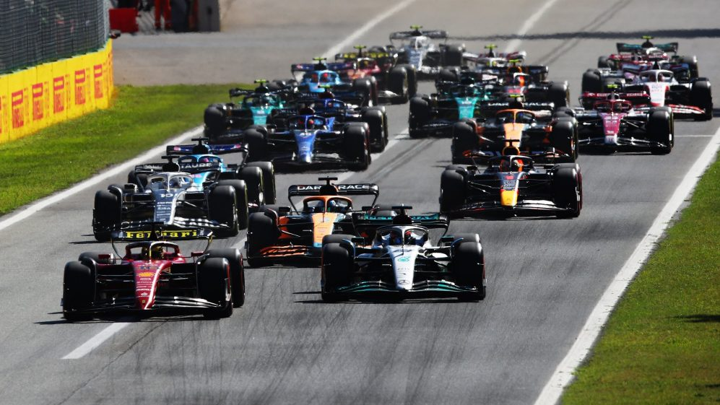
Since 1950
Present
Notes:
Firstly, I want to talk about what is F1 for those who don’t know. F1 is the highest level of car racing in the world, contested by best driver and constructor from all around the world. It has already begun from 1950 and still exist until now.

Slide 3
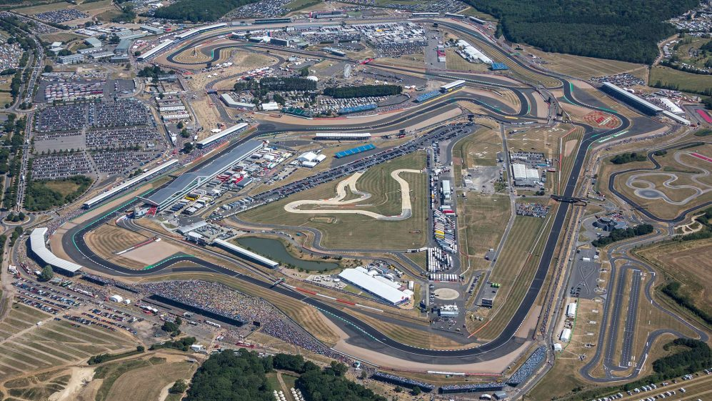
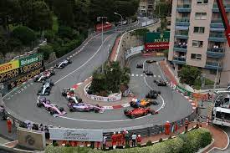
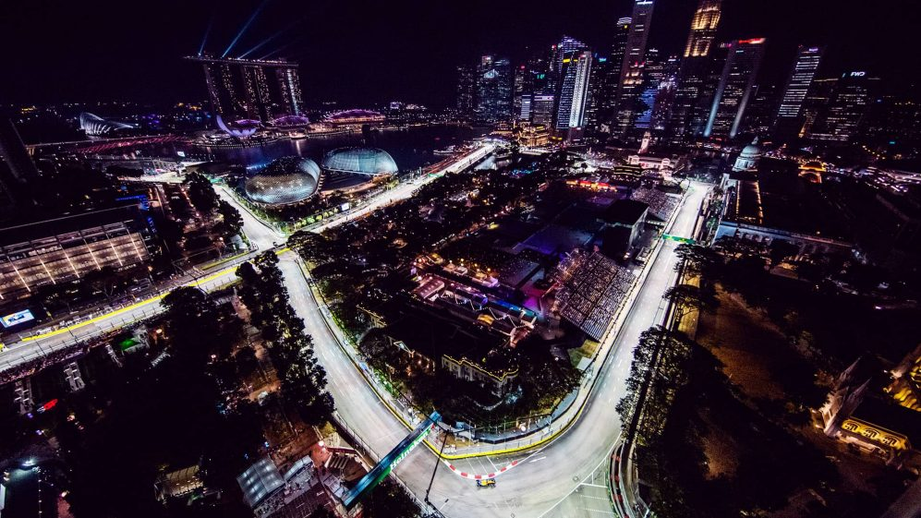
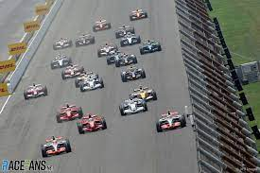
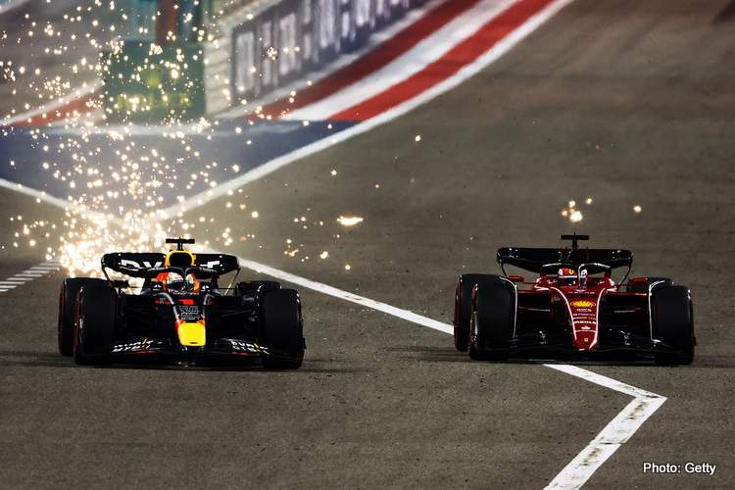
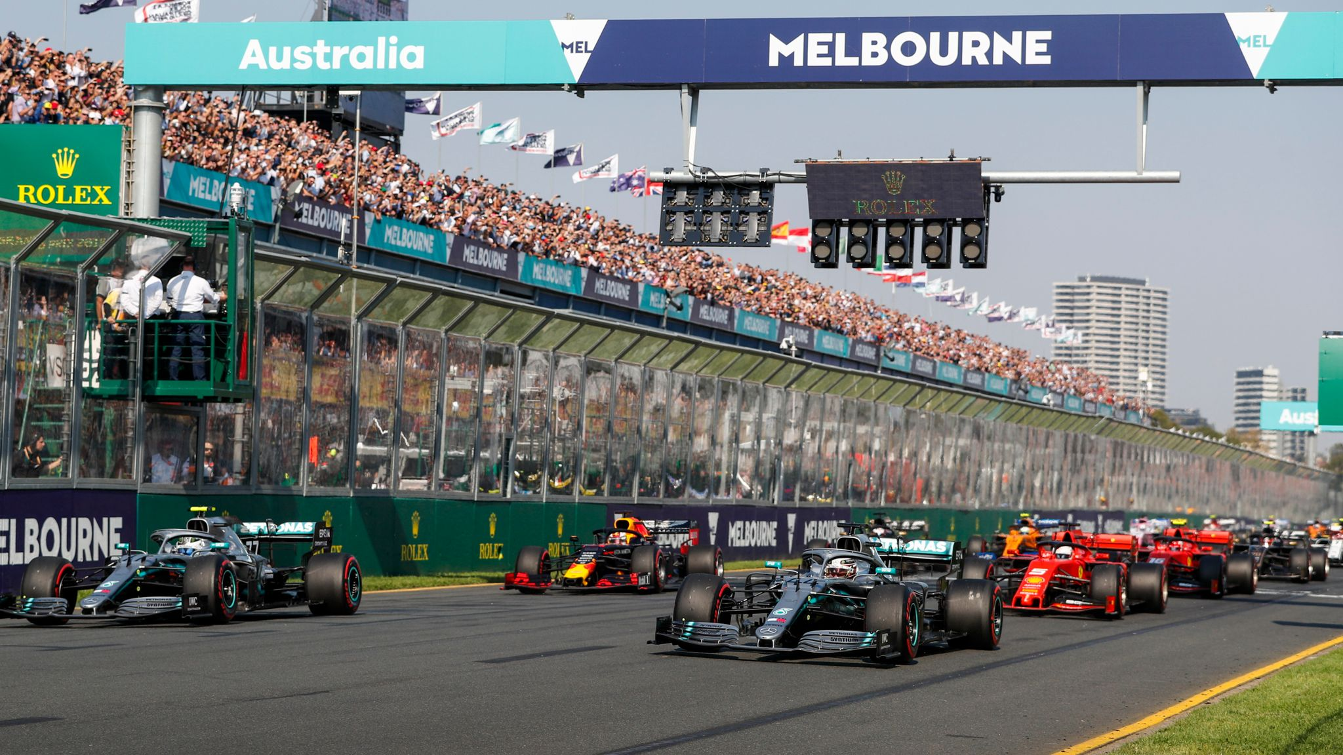
Notes:
Across those 72 years, F1 has travelled to many countries for races. They travel to UK, Monaco, USA, Australia, Bahrain and also our beloved country Singapore. They have races in a lot of circuit, but there are one question that most F1 fans will ask:

Slide 4
WHICH CIRCUIT IS the most ENTERTAINING ?
Notes:
Which circuit is the most entertaining ? Well, it’s not easy to say that, as there are a lot of factor for the race. However, today I will try to answer this question by exploring on the races, so let say I will try to find out which circuit is the most entertaining by data. Quite interesting and so, let’s begin the exploration.

Slide 5
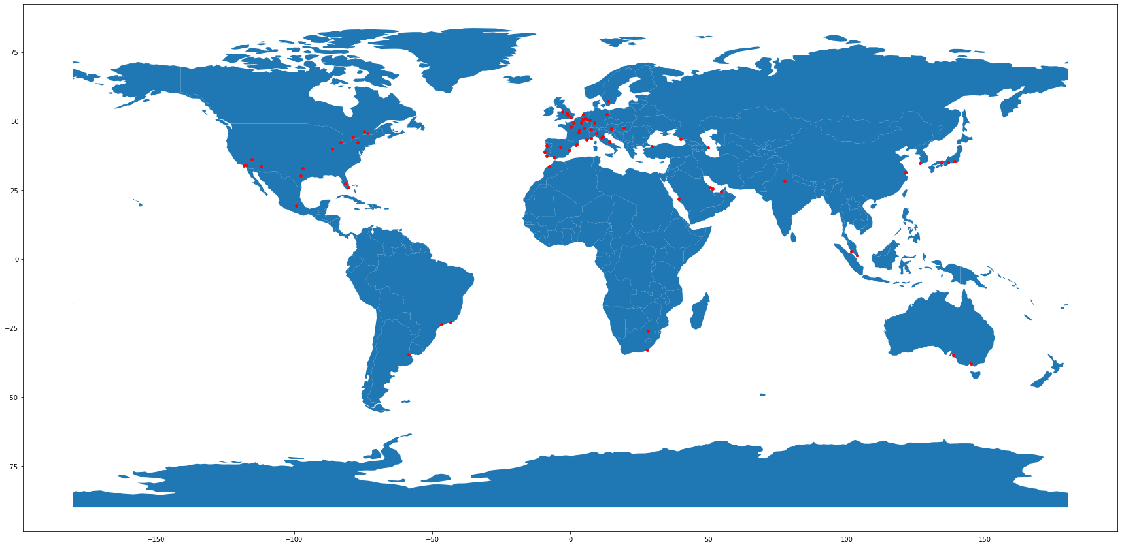
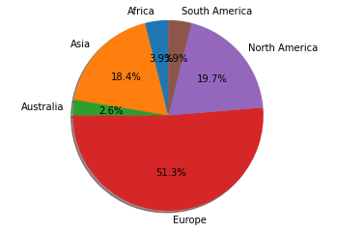
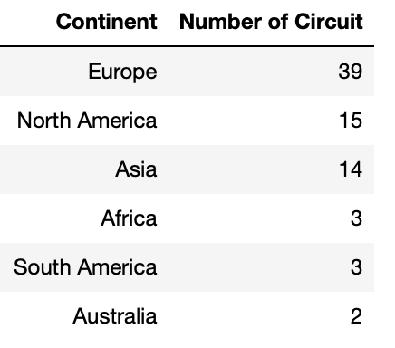
Distribution of Circuits
Notes:
Firstly, let’s look around at the distribution of the circuits. F1 has raced across the world as I said before, which makes them world championship, but as you can see in the map, most circuits that F1 has raced located in Europe. This is not surprising because in early days, only people from European participated, but across year F1 has expanded to different continent until now. Moreover, if we count the number of circuit, there are about 50% circuit in Europe, while other continent have not that much. Australia even only has 2 circuit.

Slide 6
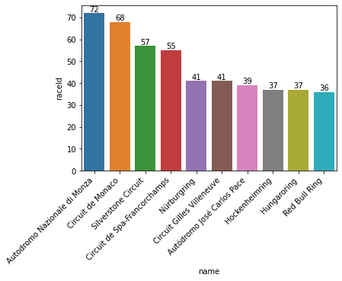
Circuit with the most race hosted
Notes:
Next, to start with our ongoing question, we want to know which circuit hosted the most races ? There must be reason why they are in every calendar of F1 and one of the possible reason is because racing there is exciting. In this case, Monza and Monaco provide the most races followed by Silverstone and Spa

Slide 7
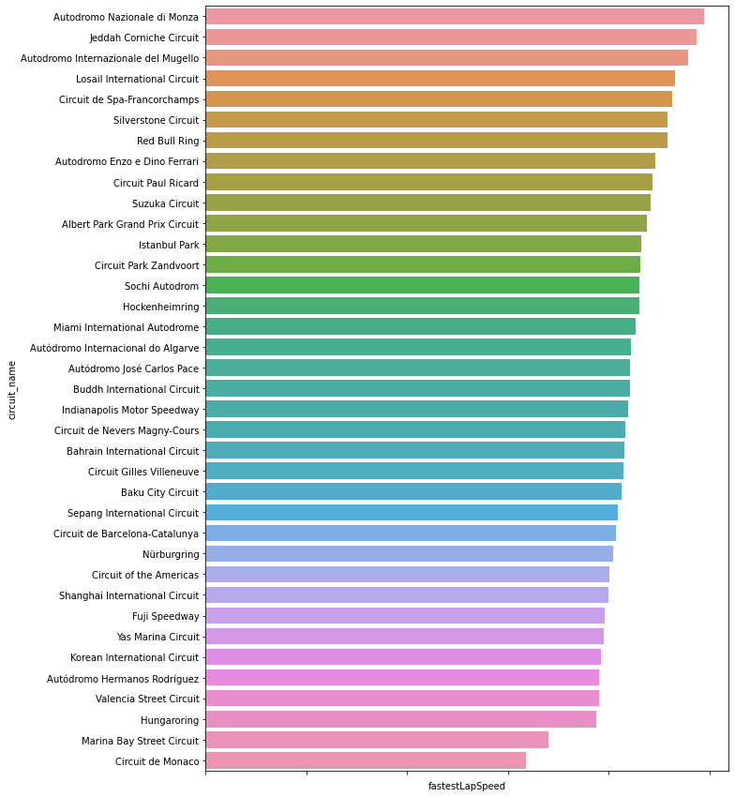
Fastest Speed
247.22 kph
88.56 kph
158.76 kph
Notes:
Next, we know that most people watch F1 because they love to see car going fast, so we want to look at the average fastest speed of a lap of F1 car. As seen in figure, for the most recent races, top 3 of the fastest circuit is Monza in Italy, Jeddah in Saudi Arabia and Mugello in Italy, while the top 3 slowest circuit goes to Monaco, Singapore and Hungary. The difference between average speed is huge, while at Monza the average speed can be about 247.22 kph, in Monaco the average is only 158.76 kph. That’s 88.56 kph in difference !

Slide 8
Actions in circuit
Overtakes
Interruption (Safety Car/Virtual Safety Car/Red Flag)
Retirement
Notes:
So after analyzing from the general perspective , we look deep into the one of what people like, which is actions in circuit that can help to entertain the races. It can be broken to 4 parts, Overtakes, Pit Stop, Interruption or Retirement. What is them all and how they can affect the race, we will lgoes deep from here.

Slide 9
OVERTAKES
Notes:
Firstly is Overtake, when 1 car overtake another to gain position, which is the philosophy of car racing. People would love to see a lot overtake in a circuit, but which circuit provide with a lot of circuit ? Let’s find out !

Slide 10
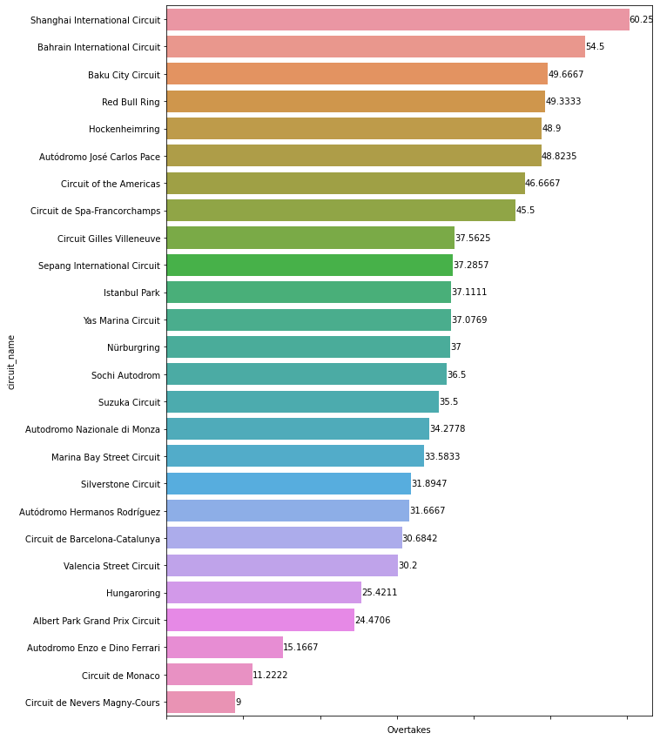
Overtakes
Notes:
Most average overtakes goes tp Shanghai, followed by Bahrain and Baku and Austria and Hockenheimring in Germany. While the one with the fewest overtake is in Magny Cours France, Monaco and Imola. However, this is still little inconclusive because we watch the race on TV and we want to find out how many Overtake was shown in TV

Slide 11
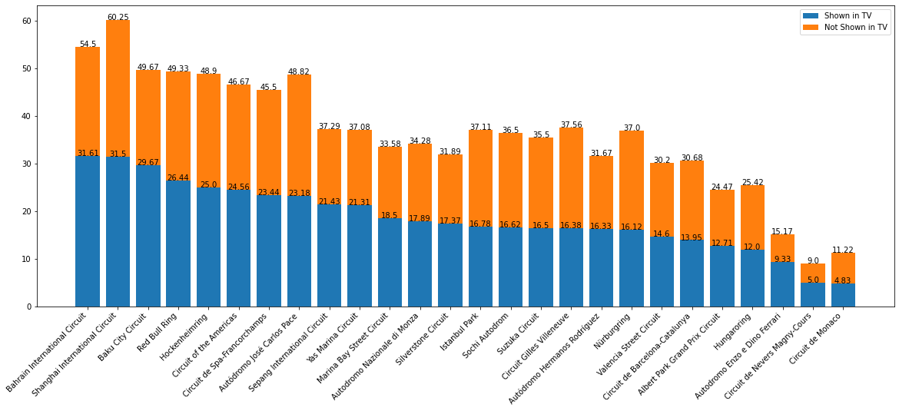
Overtakes Shown in TV
Notes:
Top 3 remains the same, but the order is difference, as Shanghai overtakes not much shown in TV as in Bahrain. Next, let’s breakdown the top 3

Slide 12
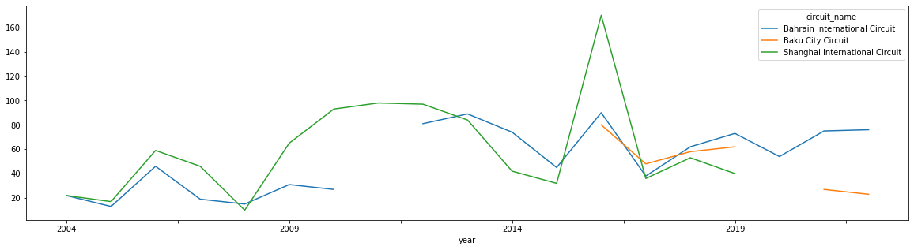
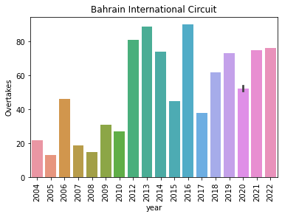
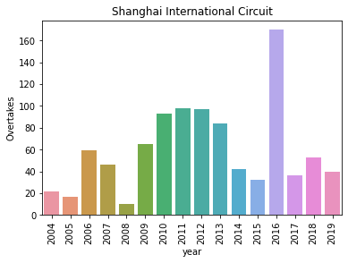
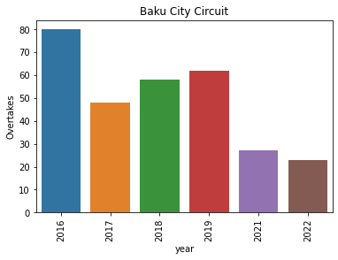
Overtakes by Circuit
Notes:
Looks like at the first graph, earlier day Shanghai is consistently ahead of both Bahrain, but in recent year Bahrain provide more overtakes, perhaps because of the latest characteristics of car more suited to Bahrain. And when we look out the number of overtakes per year, Bahrain is quite consistently high in recent year, while Shanghai have 1 outlier in 2016 and in recent there are not much overtakes, while Baku little keep declining.

Slide 13
PIT STOP
Notes:
Next is Pit Stop, where drivers make change of their tyre. This could be the factor, because it helps with the strategy, driver can take more pit stop, to have more fresher tyre at the end, which is faster, but have to loss time by making an extra stop. Circuits with more than 1 pit stop usually more entertaining because open up lot of strategy. So, which circuit have most average Pit Stop ?

Slide 14
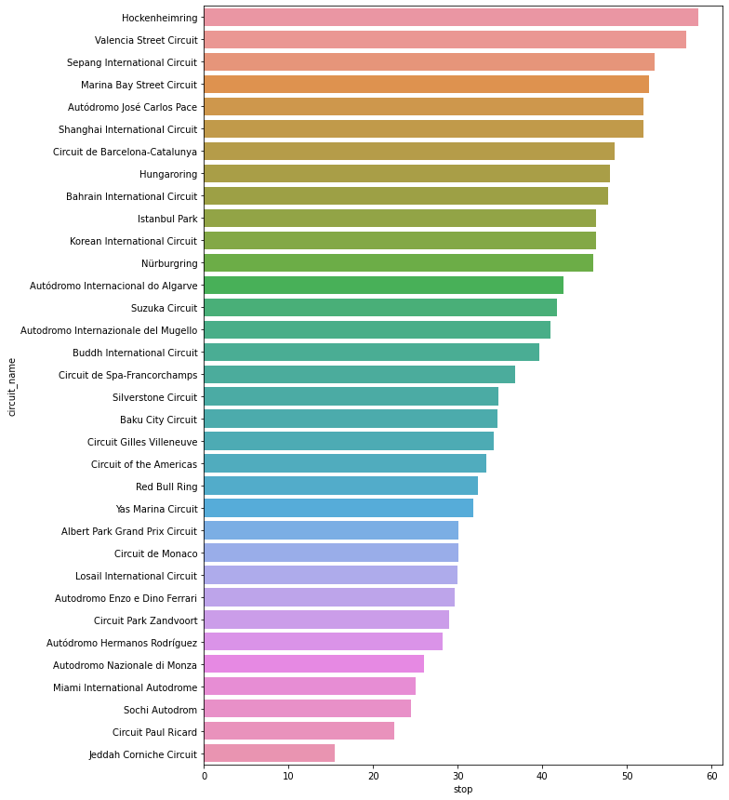
Pit Stop
Notes:
Most Pit Stop goes to Hockenheimring in Germany, which is probably because of 2019 races in changeable condition, and followed by Valencia and Sepang.

Slide 15
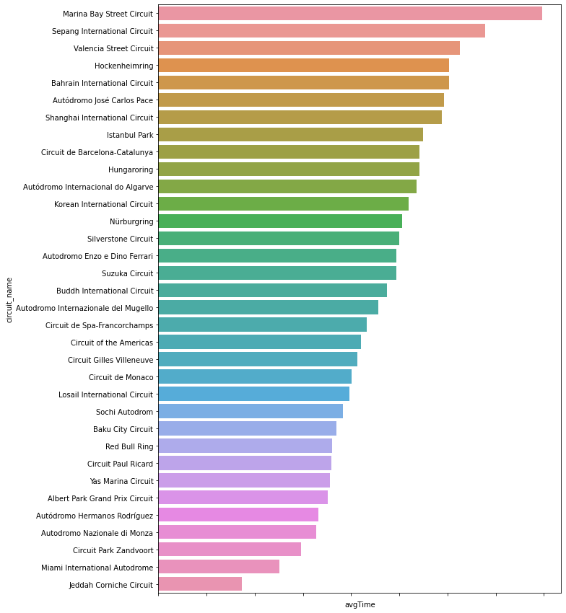
Average Pit Stop Time
Notes:
Average Pit Stop Time also interesting to look, because usually circuit with less time in Pit Stop can force driver to risk it make another Pit Stop, which the lowest average Pit Stop Loss time is in Zandvoort, Miami and Jeddah

Slide 16
INTERRUPTION
Safety Car → all car reduce speed and line up behind Safety Car
Virtual Safety Car → all car reduce 40% speed
Red Flag → the race is stopped
Why this is entertaining ?
Take less time loss for Pit Stop → most people can try to pit this time

Slide 17
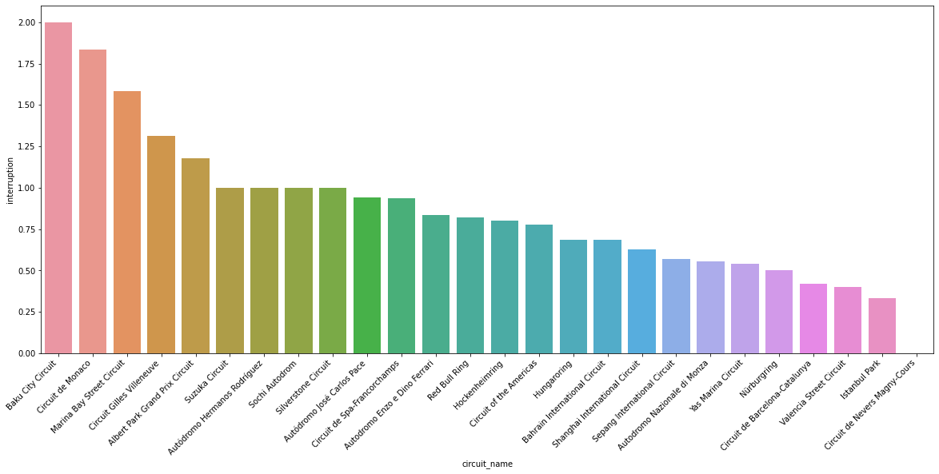
Interruption
Notes:
Firstly, we count how many interruption during race and see that Baku goes on top with most average of Interruption, followed by Monaco and Singapore. This three have common which are all are street circuit. And interruption is common there as punishment there is wall, which require Safety Car. Next, we will break down of what type of interruption

Slide 18
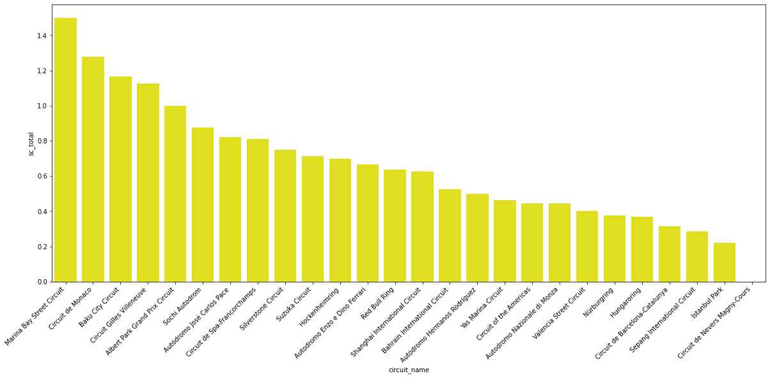
Safety Car
Notes:
For SC, the most SC deployment is in Singapore, followed by Monaco and Baku

Slide 19
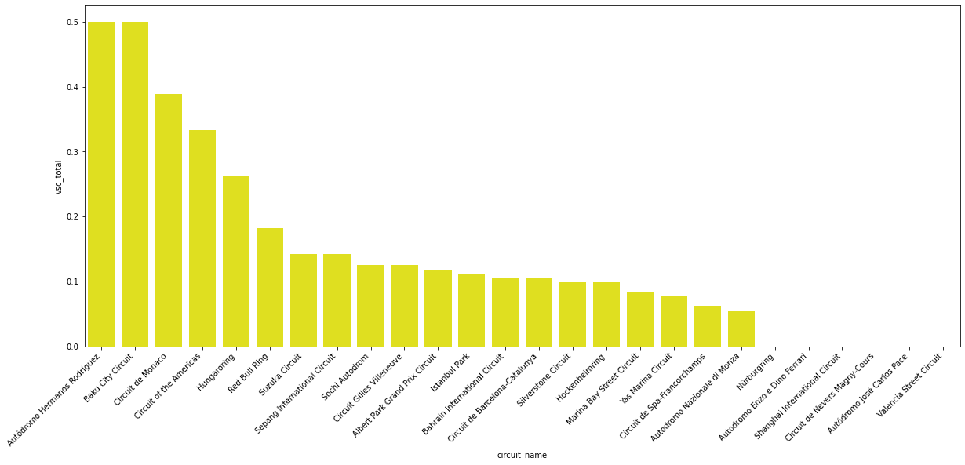
Virtual Safety Car
Notes:
For VSC, it just been implemented in 2015, the most is in Mexico, Baku and Monaco

Slide 20
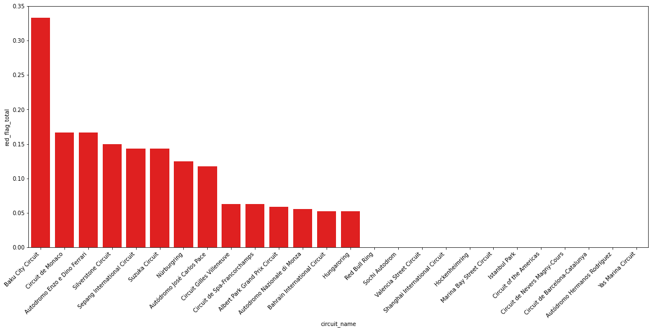
Red Flag
Notes:
While for Red Flag, which is rarely happened, the most happen is in Baku, then Monaco, then Imola, but you see that Baku have the quite a gap to below

Slide 21
RETIREMENT
Notes:
Last factor we want to look is Retirement, because it provide several surprise, so maybe front runners have to retire from the race and make races interesting. Which circuit leads to most retirement

Slide 22
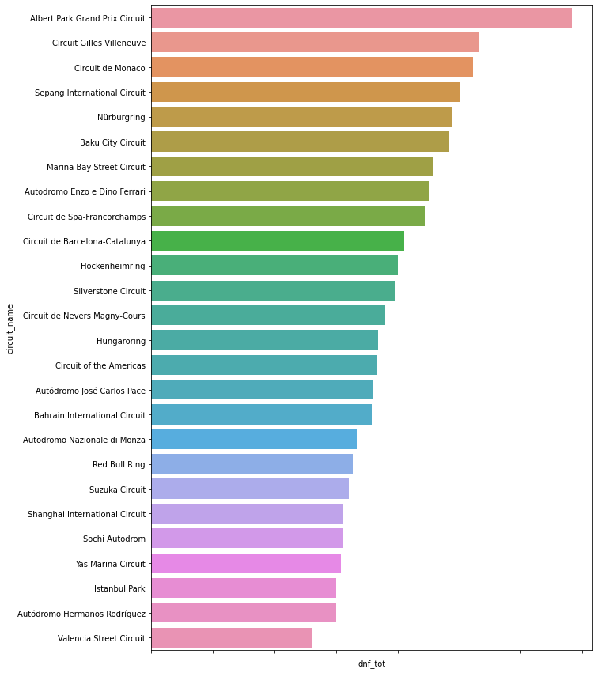
Retirement
Notes:
First one is Albert Park, which is normally opening round where car still unreliable/bad. Next one is Canada and Monaco. This retirement can be mechanical (car problem) or damage (collision with another car or spin)

Slide 23
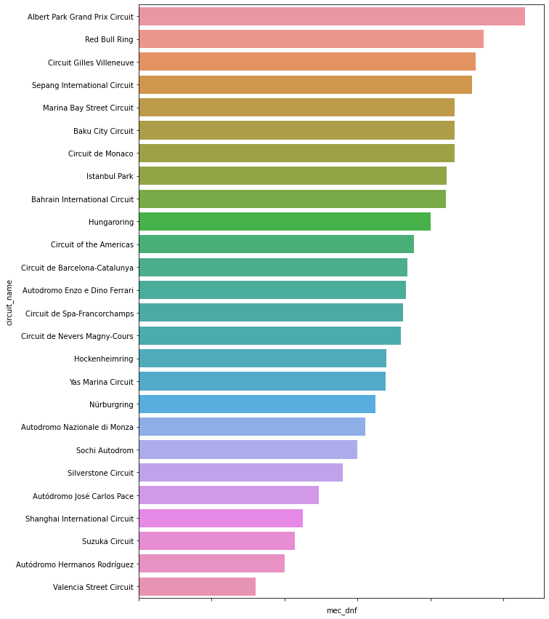
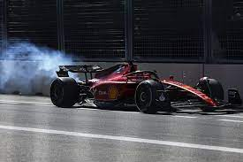
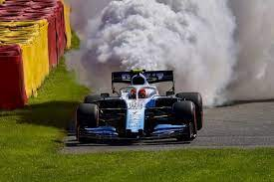
Mechanical
Notes:
Mechanical dnf quite interesting, because it gave element of surprise. No one xpect this coming. In this case, Circuit leads to most mechanical problem is Albert Park, which not surprising as car still unreliable as said before and also Canada and Austria is up there

Slide 24
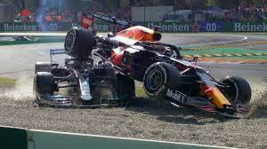
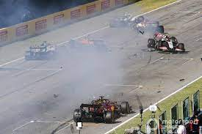
Damage
Notes:
Damage is also interesting, as unexpectedly some driver collide or spin on their own. This case, For damage is mostly in Albert park also, Austria and Canada. Notice in all this Baku still quite at the top also

Slide 25
CONCLUSION
Notes:
SO, which circuit is the most entertaining ?

Slide 26
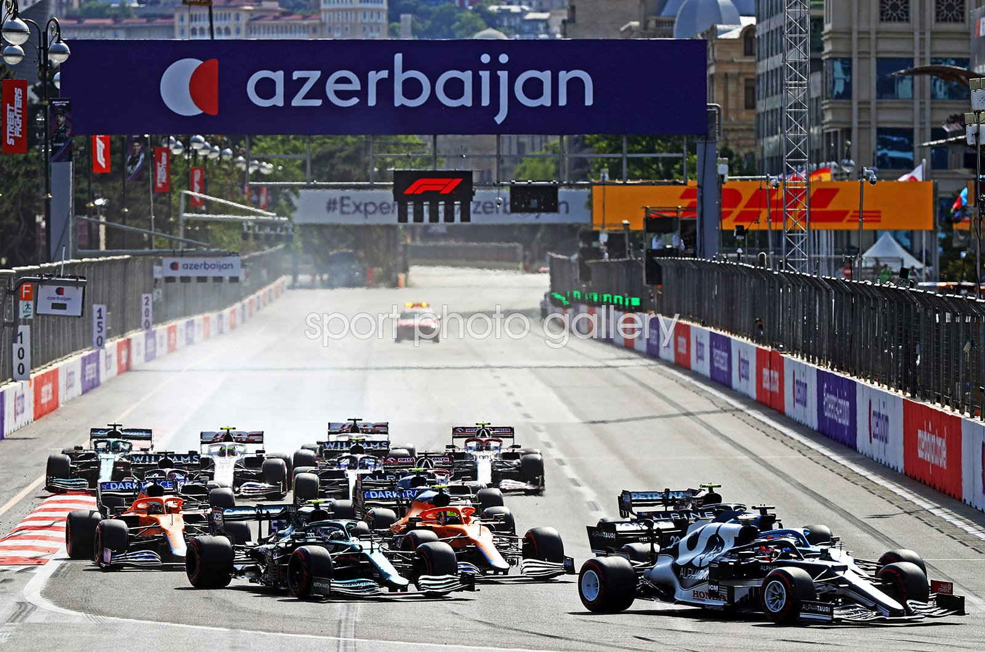
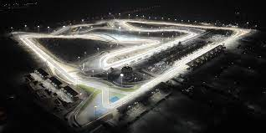
BASED ON DATA, WE NARROW DOWN TO 2
Bahrain International Circuit
Due to #Overtakes
(the most entertaining part of race)
Baku City Circuit
Due to unpredictability
(bring element of surprise)
Notes:
So, we narrow down to 2 circuit, first one is Bahrain because lot of overtakes and second one is Baku because or unpredictability (SC/VSC?RF/DNF). As a newbie, I recommend you to watch these two for starter of amazing F1 experience

Slide 27
Thank you !

